Slide 1
Insertion Sort

Slide 2
Statement of Problem
Input: A sequence of n numbers (a1, a2, . . . , an).
Output: A permutation (reordering) (a₁/,a₂/………, a_{n}/) of the input sequence such that a₁/≤a₂/≤ ……… ≤a_{n}/

Slide 3
Description
Our pseudocode for insertion sort is presented as a procedure called INSERTION-SORT which takes as a parameter an array A[1 . . n] containing a sequence of length n that is to be sorted. (In the code, the number n of elements in A is denoted by A. length)
The input numbers are sorted in place: the numbers are rearranged within the array A, with at most a constant number of them stored outside the array at any time.
The input array A contains the sorted output sequence when INSERTION-SORT is finished.

Slide 4
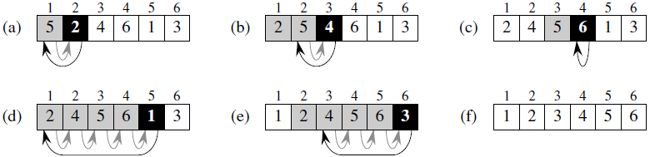
Simulation

Slide 5
Description of Previous Figure
The operation of INSERTION-SORT on the array A = (5, 2, 4, 6, 1, 3). Array indices appear above the rectangles, and values stored in the array positions appear within the rectangles.
(a)–(e) The iterations of the for loop of lines 1–8. In each iteration, the black rectangle holds the key taken from A[ j ], which is compared with the values in shaded rectangles to its left in the test of line 5. Shaded arrows show array values moved one position to the right in line 6, and black arrows indicate where the key ismoved to in line 8.
(f) The final sorted array.

Slide 6
Pseudocode
INSERTION-SORT(A)
for j = 2 to A.length
key = A[ j ]
//Insert A[ j ] into the sorted sequence A[1 . . j − 1].
i = j − 1
while i > 0 and A[i ] > key
A[i + 1] = A[i ]
i = i − 1
A[i + 1] = key

Slide 7
Loop Invariants and The Correctness of Insertion Sort
The Figure shows how this algorithm works for A = (5, 2, 4, 6, 1, 3). The index j indicates the “current card” being inserted into the hand. At the beginning of each iteration of the “outer” for loop, which is indexed by j , the subarray consisting of elements A[1 . . j −1] constitute the currently sorted hand, and elements A[ j + 1 . . n] correspond to the pile of cards still on the table. In fact, elements A[1 . . j − 1] are the elements originally in positions 1 through j − 1, but now in sorted order. We state these properties of A[1 . . j−1] formally as a loop invariant:
At the start of each iteration of the for loop of lines 1–8, the subarray
A[1 . . j −1] consists of the elements originally in A[1 . . j −1] but in sorted order.

Slide 8
Loop Invariants and The Correctness of Insertion Sort (Con’t)
We use loop invariants to help us understand why an algorithm is correct. We must show three things about a loop invariant:
Initialization: It is true prior to the first iteration of the loop.
Maintenance: If it is true before an iteration of the loop, it remains true before the next iteration.
Termination: When the loop terminates, the invariant gives us a useful property that helps show that the algorithm is correct.

Slide 9
Loop Invariants and The Correctness of Insertion Sort (Con’t)
Let us see how these properties hold for insertion sort.
Initialization: We start by showing that the loop invariant holds before the first loop iteration, when j = 2. The subarray A[1 . . j − 1], therefore, consists of just the single element A[1], which is in fact the original element in A[1]. Moreover, this subarray is sorted (trivially, of course), which shows that the loop invariant holds prior to the first iteration of the loop.
Maintenance: Next, we tackle the second property: showing that each iteration maintains the loop invariant. Informally, the body of the outer for loop works by moving A[ j −1], A[ j −2], A[ j −3], and so on by one position to the right until the proper position for A[ j ] is found (lines 4–7), at which point the value of A[ j ] is inserted (line 8).

Slide 10
Loop Invariants and The Correctness of Insertion Sort (Con’t)
Termination: Finally, we examine what happens when the loop terminates. For insertion sort, the outer for loop ends when j exceeds n, i.e., when j = n + 1. Substituting n + 1 for j in the wording of loop invariant, we have that the subarray A[1 . . n] consists of the elements originally in A[1 . . n], but in sorted order. But the subarray A[1 . . n] is the entire array! Hence, the entire array is sorted, which means that the algorithm is correct.

Slide 11
Analysis of Insertion Sort
We start by presenting the INSERTION-SORT procedure with the time “cost” of each statement and the number of times each statement is executed. For each j = 2, 3, . . . , n, where n = A.length, we let t j be the number of times the while loop test in line 5 is executed for that value of j. When a for or while loop exits in the usual way (i.e., due to the test in the loop header), the test is executed one time more than the loop body. We assume that comments are not executable statements, and so they take no time.

Slide 12
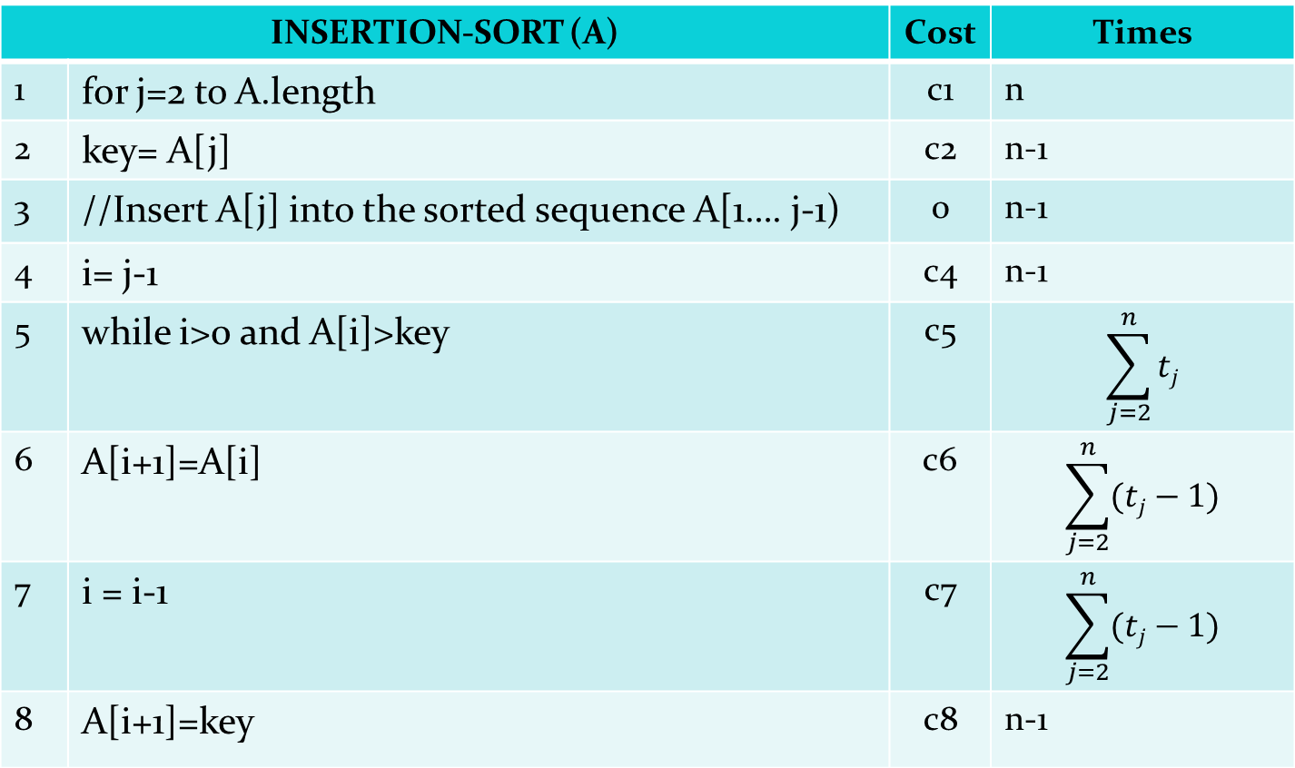
Analysis of Insertion Sort
INSERTION-SORT (A) |  | Cost | Times
1 | for j=2 to A.length | c1 | n
2 | key= A[j] | c2 | n-1
3 | //Insert A[j] into the sorted sequence A[1…. j-1) | 0 | n-1
4 | i= j-1 | c4 | n-1
5 | while i>0 and A[i]>key | c5
6 | A[i+1]=A[i] | c6
7 | i = i-1 | c7
8 | A[i+1]=key | c8 | n-1

Slide 13
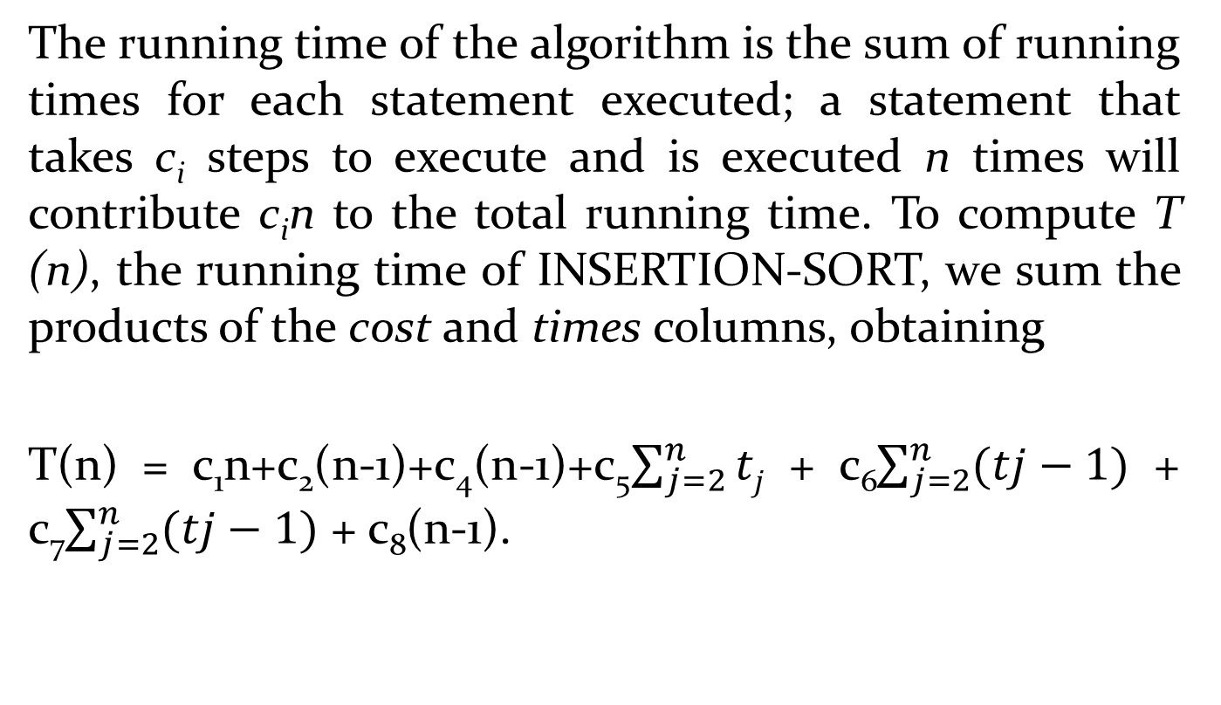
Analysis of Insertion Sort (Con’t)

Slide 14
Best Case Running Time
Even for inputs of a given size, an algorithm’s running time may depend on which input of that size is given. For example, in INSERTION-SORT, the best case occurs if the array is already sorted. For each j = 2, 3, . . . , n, we then find that A[i ] ≤ key in line 5 when i has its initial value of j − 1. Thus t_{j} = 1 for j = 2, 3, . . . , n, and the best-case running time is
T (n) = c₁n + c₂(n − 1) + c₄(n − 1) + c₅(n − 1) + c₈(n − 1)
= (c₁ + c₂ + c₄ + c₅ + c₈)n − (c₂ + c₄ + c₅ + c₈) .

Slide 15
Worst Case Running Time
In the worst case, the running time of INSERTION-SORT is
T(n) = c₁n+c₂(n-1)+c₄(n-1)+c₅((n(n+1)/2)-1)
+c₆(n(n-1)/2)+c₇(n(n-1)/2)+c₈(n-1)
= (c₅/2+c₆/2+c₇/2)n² + (c₁+c₂+c₄+c₅/2-c₆/2
-c₇/2+c₈)n – (c₂+c₄+c₅+c₈)

Slide 16
Thank You

